Slide 1
Unit 4
7.1/7.2: Variable and Linear Equations
7.3: Linear Equations with Fractions and Decimals
8.1: Formulas

Slide 2
Evaluating/Rearranging Formulas
Often the application of mathematics involves the use of a formula.
Evaluating a formula – substituting the known variable values into the formula and solving the resulting equation for the unknown value
Rearranging a formula – solving the formula for a designated variable

Slide 3
Evaluating/Rearranging Formulas
Solve the formula $P=2(l+w)$ for $w$ if $P=12 ft$ and $l=4 ft.$ (Example)
$$P=2(l+w)$$
$$4=2w$$
$$12=2(4+w)$$
$$2 ft=w$$
$$12=8+2w$$

Slide 4
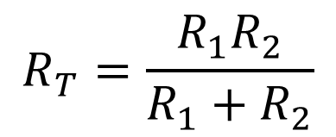
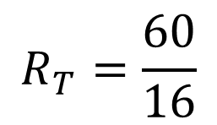
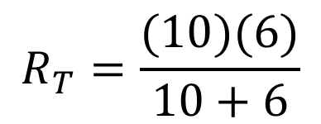
Evaluating/Rearranging Formulas
Evaluate the formula $R_{T}=\frac{R_{1}R_{2}}{R_{1}+R_{2}}$ if $R_{1}=10Ω$ and $R_{2}=6Ω$. (Example)
$$R_{T}=\frac{R_{1}R_{2}}{R_{1}+R_{2}}$$
$$R_{T}=\frac{60}{16}$$
$$R_{T}=3.75 Ω$$
$$R_{T}=\frac{(10)(6)}{10+6}$$

Slide 5
Evaluating/Rearranging Formulas
If we want to use a business formula in an Excel spreadsheet we may need to rearrange that formula by solving for a designated variable.

Slide 6
Evaluating/Rearranging Formulas
Solve $PV=nRT$ for $V.$ (Example)
$PV=nRT$
$$V=\frac{nRT}{P}$$
$$P P$$

Slide 7
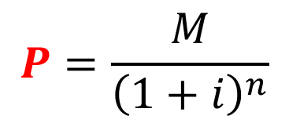
Evaluating/Rearranging Formulas
Solve $M=P{\left(1+i\right)}^{n}$ for $P.$ (Example)
$M =P{\left(1+i\right)}^{n}$
$$P=\frac{M}{{\left(1+i\right)}^{n}}$$
$${\left(1+i\right)}^{n} {\left(1+i\right)}^{n}$$

Slide 8
Evaluating/Rearranging Formulas
Solve $M=P\left(1+RT\right)$for R$.$ (Example)
$$M=P\left(1+RT\right)$$
$$M−P=PRT$$
$$PT PT$$
$$M=P+PRT$$
$$R=\frac{M−P}{PT}$$
$$M−P=P+PRT−P$$

